Slide 1


EAT HEALTHY AND
STAY HEALTHY
By - Jahanvi

Slide 2
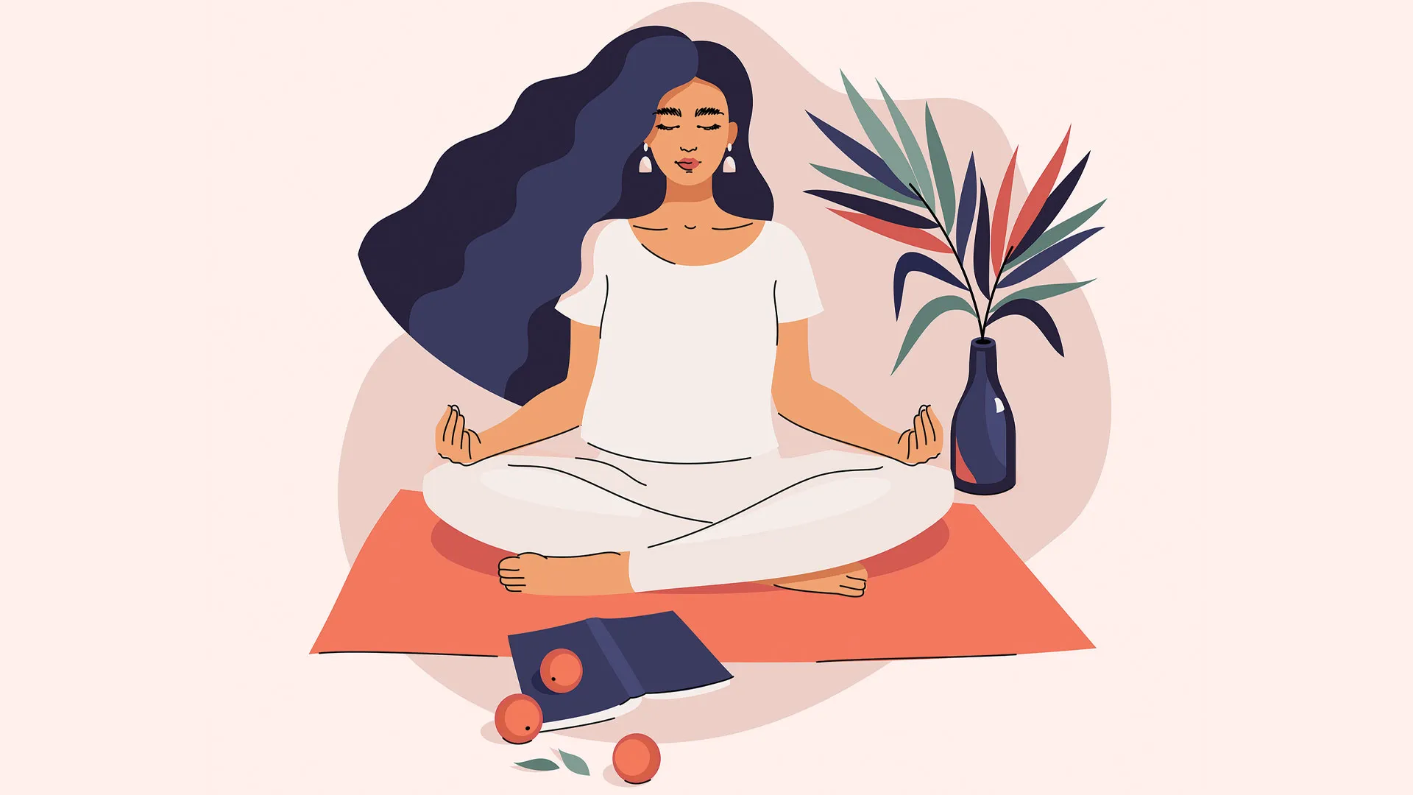
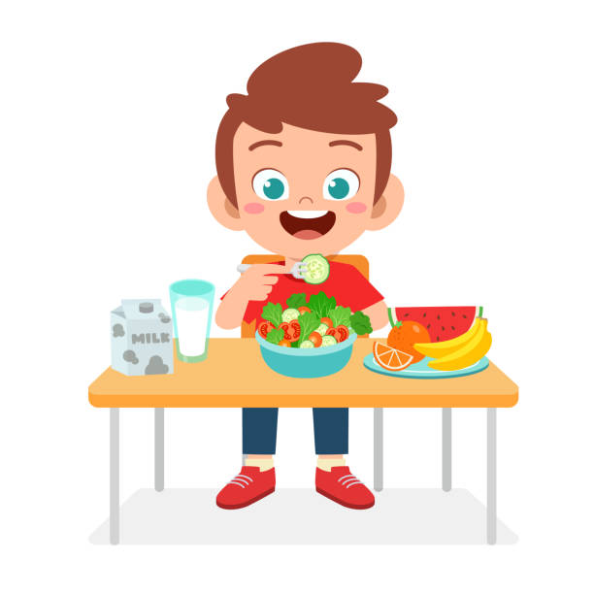

What is Healthy Eating?
Increases Happiness
Prevents Chronic and Health Risks
Improves Health

Slide 3
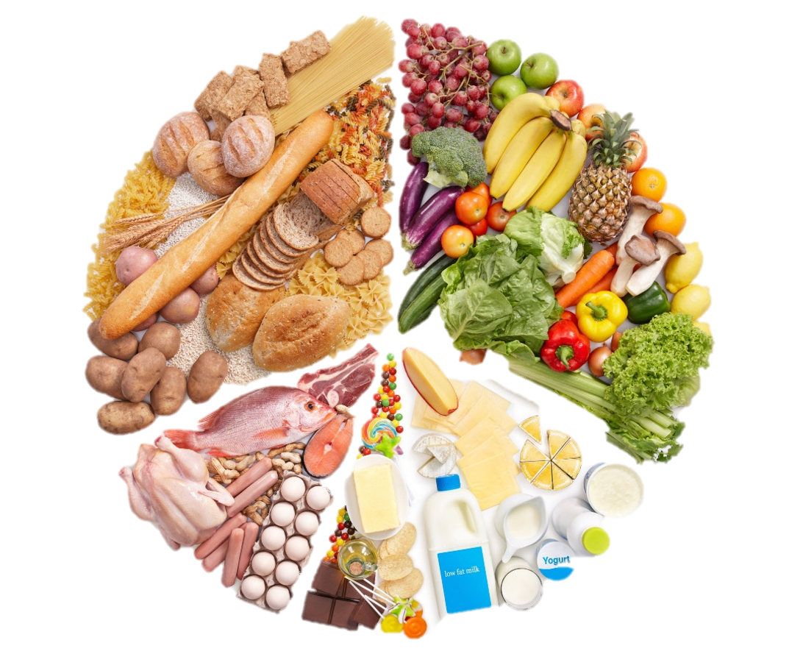


What you eat effects your MIND, BODY & EMOTIONS
Eat Balanced Diet
Bread other Cereals and Potatoes
Fruits & Vegetables
Milk & Dairy Foods
Meat, Fish & Alternatives
Food containing fat/sugar

Slide 4
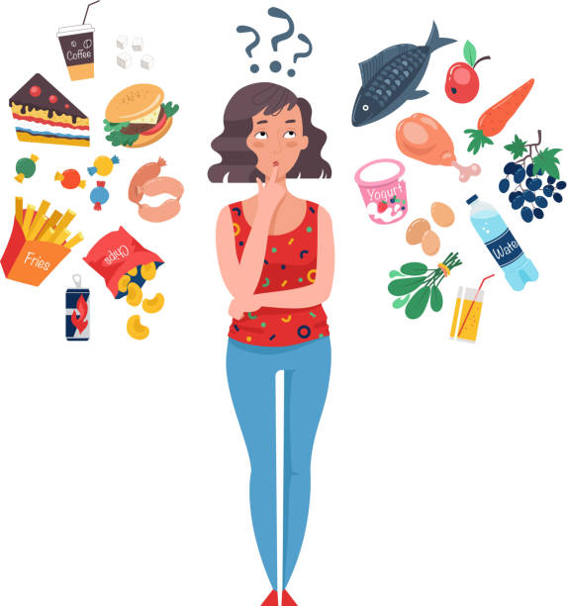
Smart STRATEGIES
Eat small meals throughout the day.
Chew Slowly.
Drink plenty of water.
Avoid eating stale and fried food.
Eat variety of colorful fruits and vegetables.
Balance calorie intake and burn properly.

Slide 5
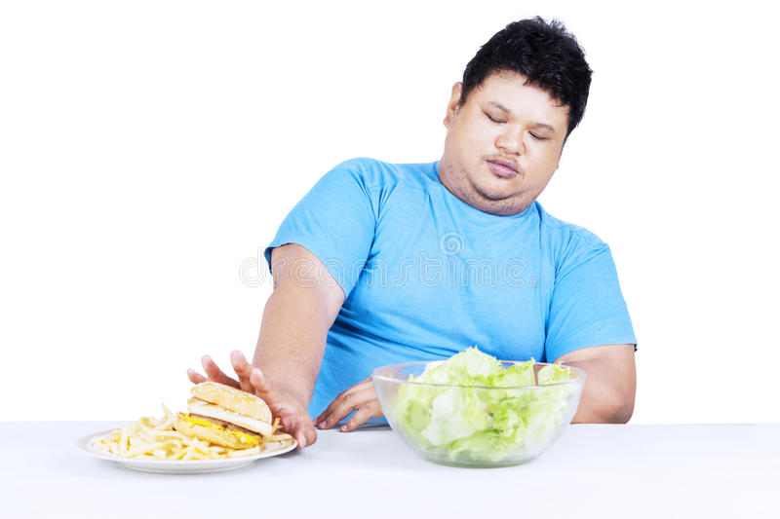

PRECAUTIONS
Avoid eating stale and fried food.
Limit sugary foods, salt, and refined grain products

Slide 6


